Slide 1
MOVIEON:ONLINE MOVIE TICKET BOOKING APPLICATION
By
Shubham Kukreti
02415003117

Slide 2
INTRODUCTION
My project MovieOn: Online Movie Ticket Booking Portal basically manages the ticket booking process of a multiplex, providing an interface to the user to book movie tickets in a more easy way.
At the front end I have used React.Js and at the back end Express.Js and MongoDB.
The project proceeds through a sequence of well-designed forms provided with validations to ensure consistency, reliability and most importantly correctness of information fed into the database.

Slide 3
TECHNOLOGIES USED
REACT
EXPRESS.JS
AXIOS
MONGODB
CRYPTO-JS
BODY PARSER

Slide 4
What is REACT ?
React is a javascript library.
Used to create frontend UI of web applications.
Everything is a component.

Slide 5
EXPRESS.JS
Express.js is a web application framework for Node.js.
It is designed for building web applications and APIs.
To use express in our Project , First of all we use below command to install express and use it.
$ npm install express
where npm stands for node package manager.

Slide 6
AXIOS

Slide 7
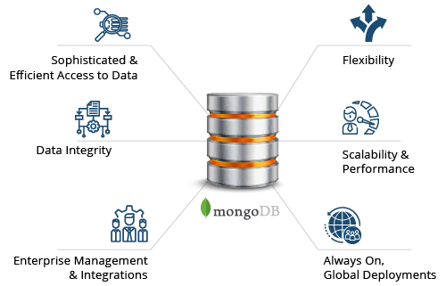
MONGODB
IS A NOSQL DATABASE.

Slide 8
Project ScreenShots

Slide 9
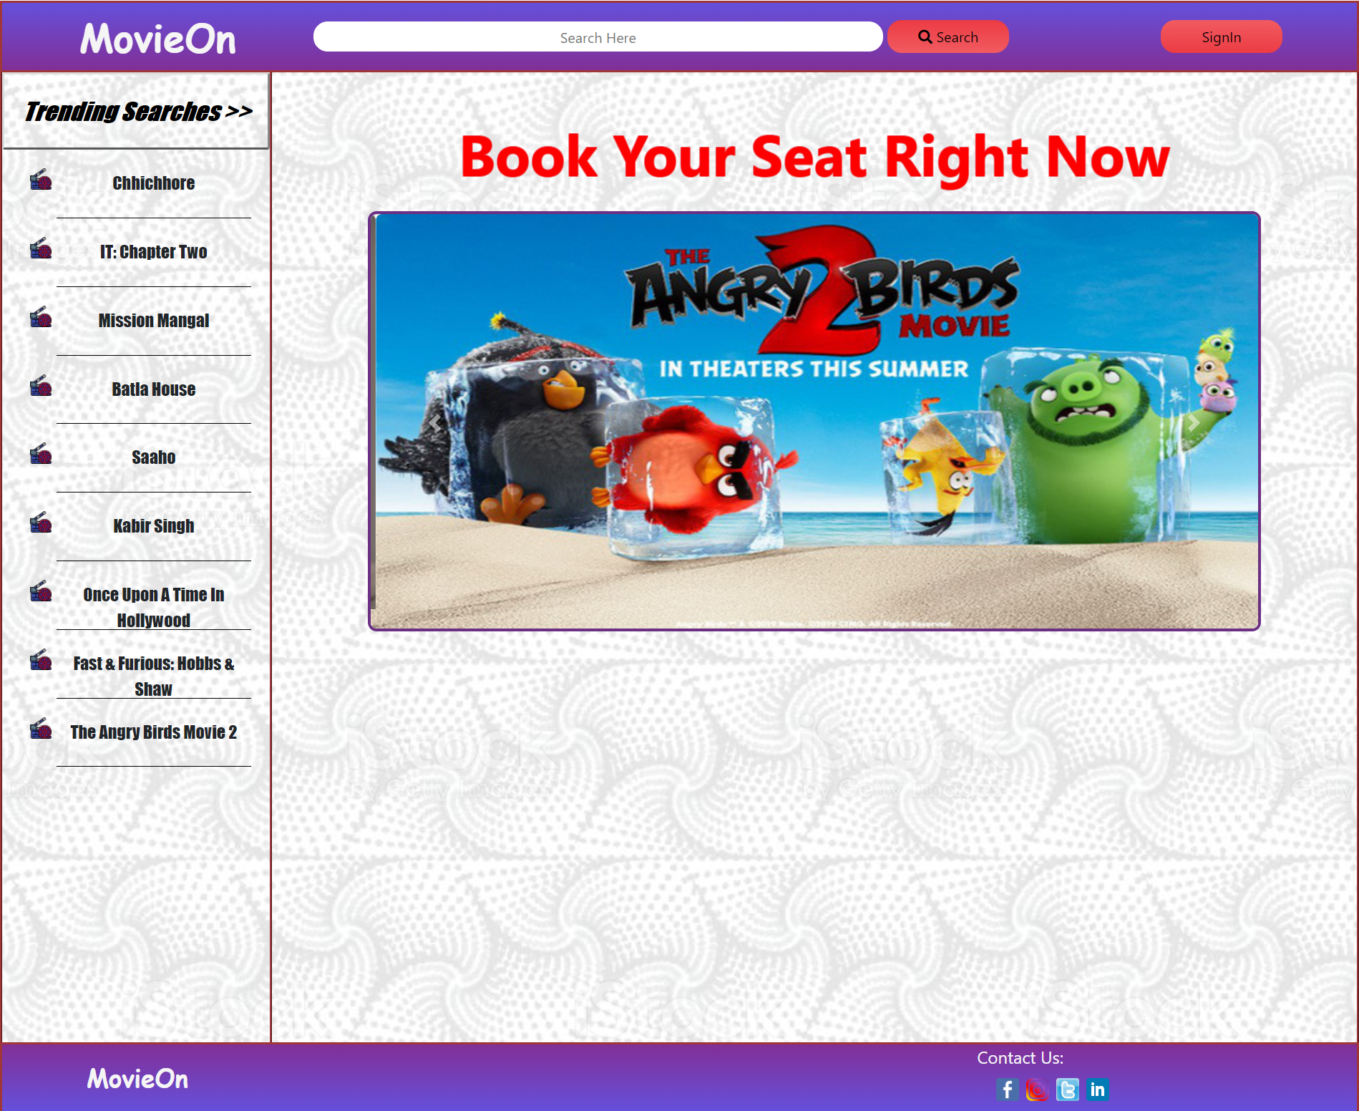
Homepage (before signin)

Slide 10
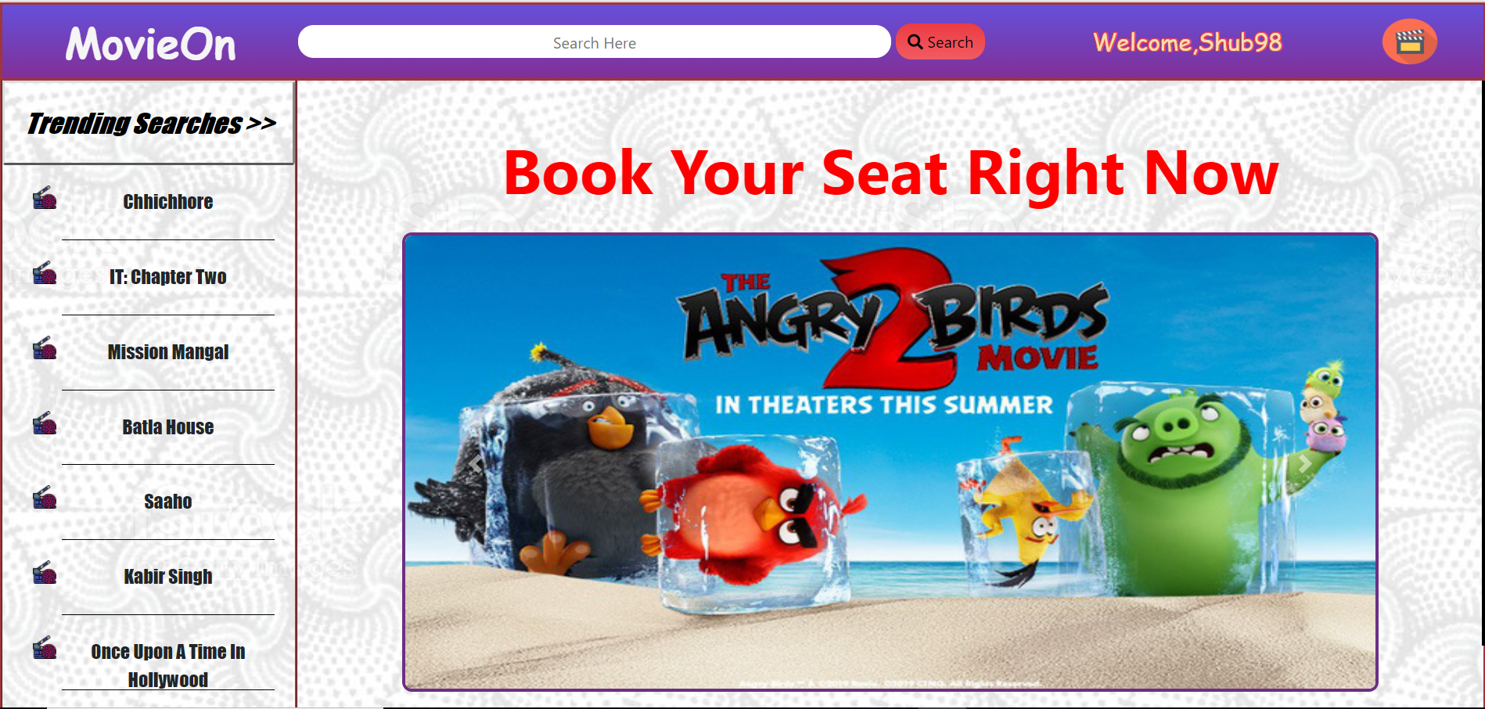
Homepage (After SignIn)

Slide 11
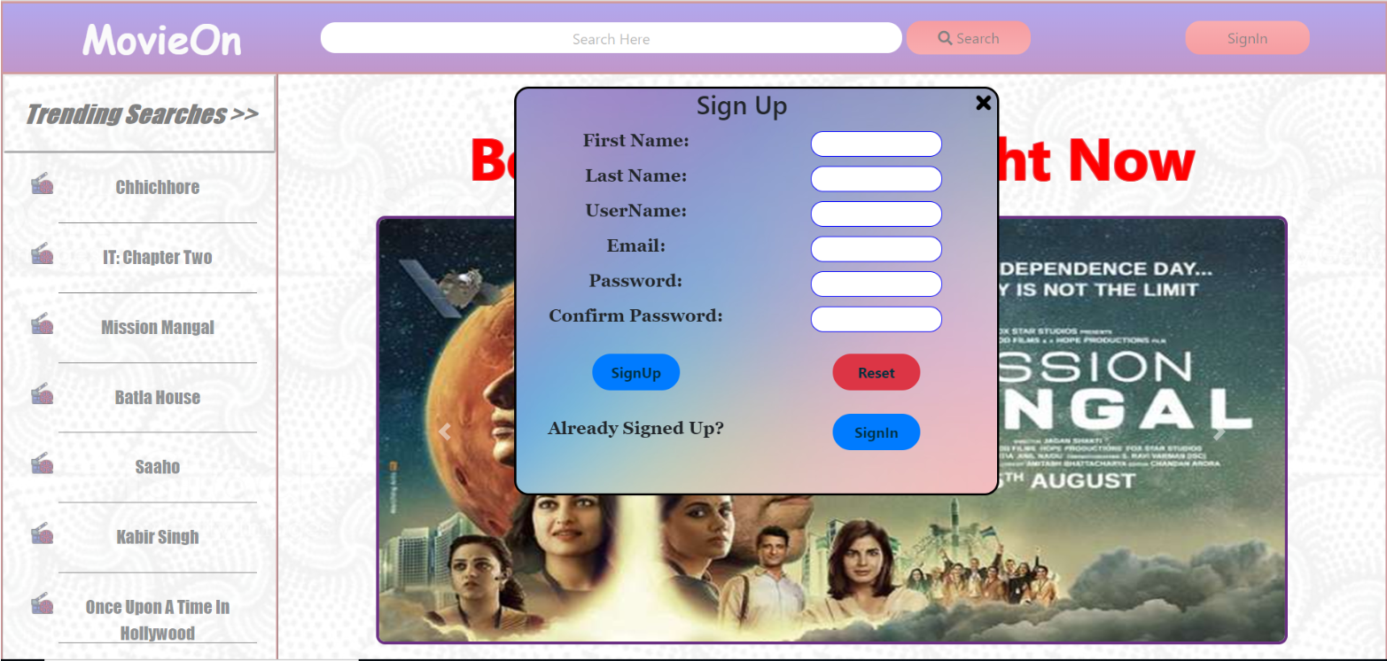
SignIn/SignUp Component

Slide 12
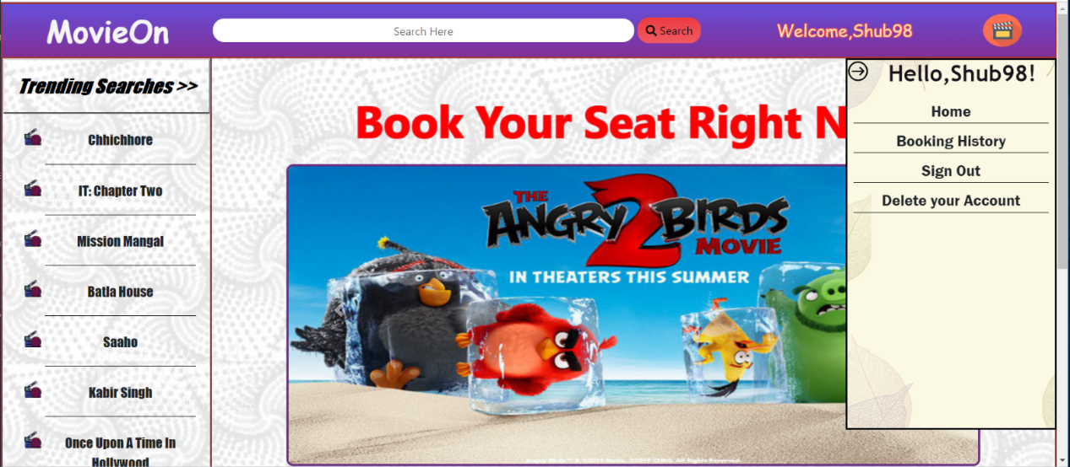
Menu Component (After SignIn)

Slide 13
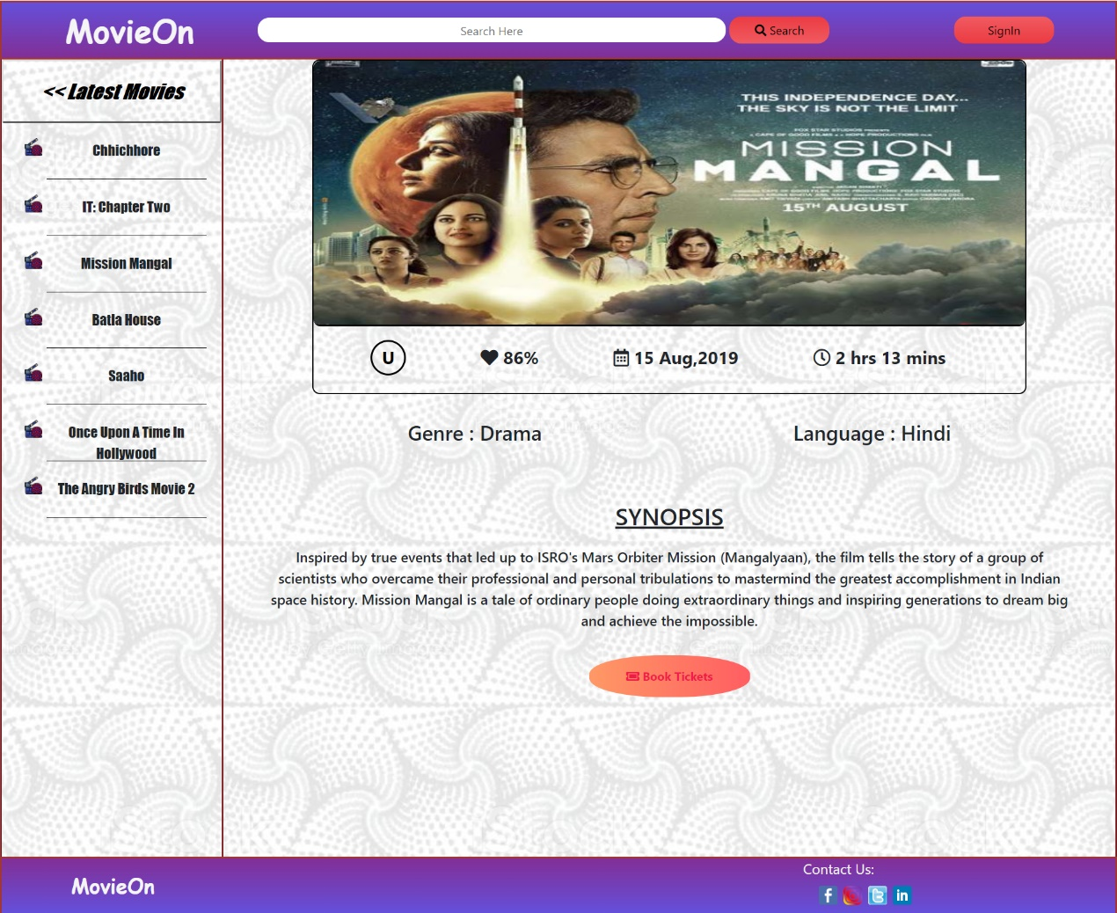
Middle Component

Slide 14
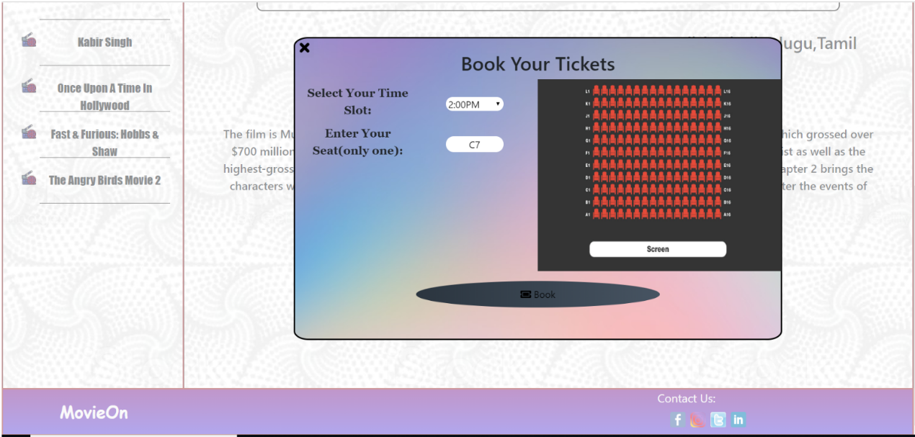
Booking Component

Slide 15
Conclusion
There is a wide acceptance of online platform in today era in all over the world due to internet facilities available
Online platform complete all the needs of people in all the situation and provide many features to all users.
We provide a safe and secure applicaction so that users can’t have any issue regarding our application.
Always keep the data of the users encrypted using different algorithms and keep updating our application time to time.

Slide 16
Future Scope
Adding more features to the Application like Payment gateway etc.
Adding More Features to Booking Interface.
Adding of movie trailers with the details.
Making frontend more interactive through which user can easily interact with our application.

Slide 17
THANK YOU

